Slide 1

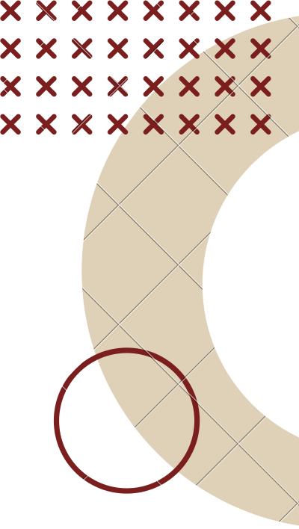
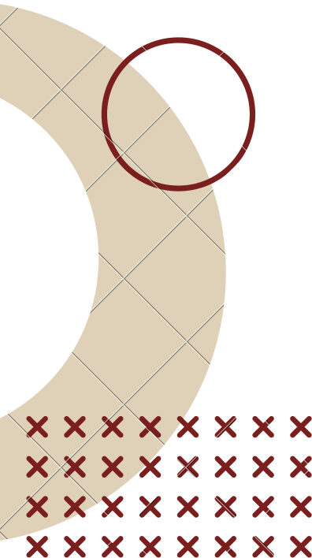

CALCVAULT
PRESENTED BY: JYOTHI SAKTHI H 220701113
III CSE E

Slide 2
INTRODUCTION
In today's digital age, protecting personal data has become increasingly important. Traditional apps for file security often attract attention or fail to provide stealthy protection. CalcVault addresses this concern by offering a secure and discreet vault application that mimics a calculator interface, ensuring users can hide and access sensitive media files without raising suspicion. This project integrates robust authentication, encryption, and a stealth UI, making it ideal for users who prioritize both privacy and usability on Android devices.

Slide 3
OBJECTIVE
To develop a secure vault application that hides sensitive files behind a calculator interface.
To implement authentication mechanisms such as PIN-based login for user privacy.
To ensure encrypted storage of media files within a disguised environment. To provide a user-friendly interface that blends with normal app usage.
To enable features like file import, export, and removal within the vault. To enhance user trust and data confidentiality through stealthy design.

Slide 4
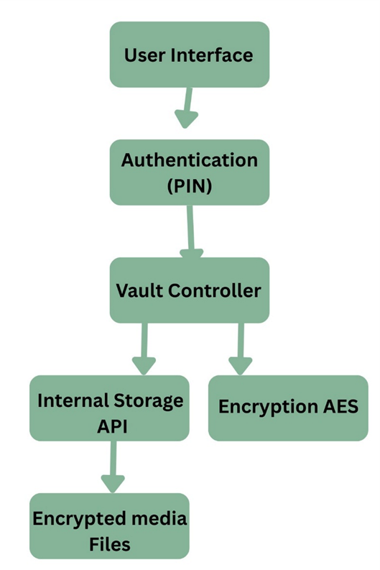
SYSTEM ARCHITECTURE

Slide 5
METHODOLOGY
Requirement Analysis
Identified the need for secure media storage with a disguised interface. Studied existing vault and disguise applications.
Design
Designed UI to resemble a calculator for stealth. Created system flow: Login → Calculator → Vault access.
Backend Development
Implemented secure storage with encrypted access. Integrated authentication (PIN) and error handling.
Frontend Implementation
Developed a responsive and realistic calculator interface using Android Studio. Enabled file import/export, preview, and deletion.
Testing
Conducted functionality and usability tests to ensure robustness. Addressed edge cases and handled invalid access attempts.

Slide 6
IMPLEMENTATION
Platform & Tools Android Studio (Java) XML for UI design
SQLite for local storage
User Interface
Disguised home screen as a simple calculator
Hidden vault access triggered by specific PIN Smooth transition from calculator to vault
Core Functionality
Add, view, and delete media files PIN-based authentication
Secure storage of media in hidden directories
Security Features
Blocks unauthorized access
Vault files hidden from regular gallery apps

Slide 7
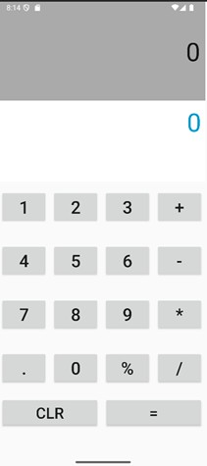
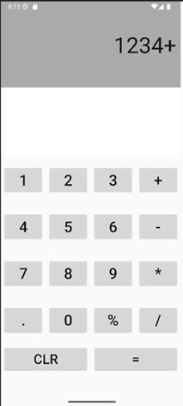
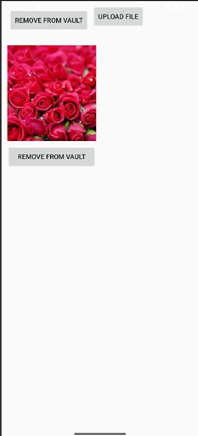
RESULT

Slide 8
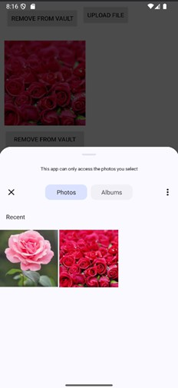
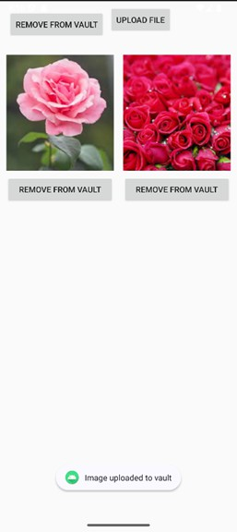
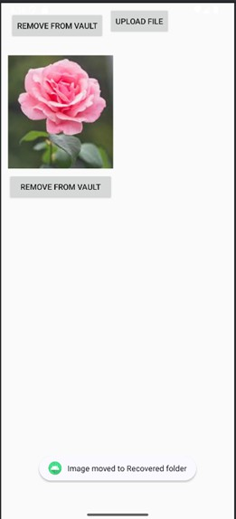
RESULT

Slide 9
CONCLUSION & FUTURE WORKS
Conclusion
Successfully developed a secure Android app that hides private media behind a functional calculator interface.
Ensures user privacy by using PIN-based authentication and hidden directories.
Offers a simple, intuitive design with strong emphasis on user trust and ease of use.
Future Work
Cloud Backup: Add encrypted cloud storage for file backup and recovery.
Intruder Detection: Capture photo on failed login attempts.
Multiple Vaults: Support different vaults for different PINs.
Biometric Access: Integrate fingerprint or face authentication for quicker access.

Slide 10
THANK YOU

